Slide 1
William Hogarth, A Just View of the British Stage (Undated, c18, collection of the V&A)

Slide 2
Bodily Moralities
Introducing Fielding’s drama

Slide 3
Bodily Moralities
Fielding, Farce and Comic Compassion
Defining farce
‘Essay on the Knowledge of the Characters of Men’ (1743)
The Author’s Farce (1730)
Grub-street, the Scriblerians and the theatre
Wooden actors, wooden texts
Pasquin (1736)
‘Generic miscegenation’
Theatrical politics

Slide 4
Defining Farce
Farce is…
purgative:
there is the same difference betwixt Farce and Comedy, as betwixt an Empirique and a true Physitian: both of them may attain their ends; but what the one performs by hazard, the other does by skill
(Dryden, preface to An Evening’s Love, 1671)
Ridicule, like Ward’s Pill, passes innocently through a sound Constitution; but when it meets with a Complication of foul Distempers in a gross corrupt Carcase, it is apt to give a terrible Shock, to work the poor Patient most immoderately; in the Course of which Working, it is ten to one but he bes---ts his Breeches.
(Fielding, ‘A Letter to Common Sense: or, The Englishman’s Journal,’ No. 16. Sat, May 21, 1737)
Burlesque ‘contributes more to exquisite Mirth and Laughter than any other; and these are probably more wholesome Physic for the Mind, and conduce better to purge away Spleen, Melancholy and ill Affections, than is generally imagined. Nay, I will appeal to common Observation, whether the same Companies are not found more full of Good-humour and Benevolence, after they have been sweeten’d for two or three Hours with Entertainments of this kind, than when soured by a Tragedy or a grave Lecture.’
(Fielding, preface to Joseph Andrews, 1742)

Slide 5
hyperbolical:
As Tragedy prescribes to Passion Rules,
So Comedy delights to punish Fools;
And while at nobler Game she boldly flies,
Farce challenges the Vulgar as her Prize.
Some Follies scarce perceptible appear
In that just Glass, which shews you as you are.
But Farce still claims a magnifying Right,
To raise the Object larger to the Sight,
And shew her Insect Fools in stronger Light.
(Fielding, prologue to The Lottery, 1732)
The English addiction to caricature: ‘they are more struck with a large face and great nose designed by Callot that with a noble and graceful countenance trac’d by Corregio’s pencil. For this reason their comic characters are more overstrain’d than ours.’
(Abbé le Blanc, 1737)

Slide 6
unnatural:
‘So Comedy may admit of Humour, which is a great Province of Farce; but then it might be such Humour as comes within the compass of Nature and Probability: For where it exceeds these Bounds it becomes Farce.’
(Nahum Tate, preface to A Duke and No Duke, 1693)
‘Affectation always over-acts her Part, it fares with her as with a Farcical Actor on the Stage, whose monstrous over-done Grimaces are sure to catch the Applause of an insensible Audience; while the truest and finest Strokes of Nature, represented by a judicious and just Actor, pass unobserved and disregarded.’
(Fielding, Essay on the Knowledge of the Characters of Men, 1743).
‘Farce … consists principally of Grimaces’
(Dryden, preface to An Evening’s Love, 1671)
‘I would ask the Reader’s Opinion if he can suppose any more genuine and natural Use of those Larvae or Vizards … than for Farce-Players’
(Nahum Tate, preface to A Duke and No Duke, 1693)
Grimace, def. 1. ‘distortion of the countenance from habit, affectation, or insolence.’
2. an ‘Air of affectation’
(Johnson, Dictionary, 1755)
Notes:
Affectation and farce conflated – affectation is just the form farce takes in real life

Slide 7
pure invention:
Farce is more difficult to write than comedy; ‘there are no Rules to be prescribed for that sort of Wit, no Patterns to Copy, ‘tis altogether the Creature of Imagination.’
‘Genuis and Invention [are] beyond the best Performances of Imitation. Such is the Farce-Writers Task.’
(Nahum Tate, preface to A Duke and No Duke, 1693)
‘in Farce the author is not tied to the same severity of Rules as in Comedy; Farce is more loose and disengaged, not cramp’d by Method, or measure of Time or other Unity: ‘Tis a Hodge-podge of Adventures, things reasonable mixt with things unreasonable; . . . Just as if War were to be waged against Sense and Uniformity, and the quidlibet audendi were all that the Poet is to Study.’
(Charles Gildon, Comparison between the Two Stages, 1702)

Slide 8
however Self-Love may make us pleased with seeing a Blemish in another which we are ourselves free from, yet Compassion on the first Reflection of any Unhappiness in the Object, immediately puts a Stop to it in good Minds. For Instance; suppose a Person well drest should tumble in a dirty Place in the Street; I am afraid there are few who would not laugh at the Accident: Now what is this Laughter other than a convulsive Extasy, occasioned by the Contemplation of our own Happiness, compared with the unfortunate Person’s! a Pleasure which seems to savour of Ill-nature: but as this is one of those first, and as it were, spontaneous Motions of the Soul, which few … attend to, and none can prevent; so it doth not properly constitute the Character. When we come to reflect on the Uneasiness this Person suffers, Laughter, in a good and delicate Mind, will begin to change itself into Compassion; and in Proportion as this latter operates on us, we may be said to have more or less Good-Nature: but should any fatal Consequence, such as a violent Bruise, or the breaking of a Bone, attend the Fall, the Man who should still continue to laugh, would be entitled to the basest and vilest Appellation with which any Language can stigmatize him.
(Fielding, ‘Essay on the Knowledge of the Characters of Men,’ 1743)
Comedy ‘works first on the ill nature of the Audience; they are mov’d to laugh by the representation of deformity; and the shame of that laughter, teaches us to amend what is ridiculous in our manners.’
(Dryden, Preface to An Evening’s Love, 1671)

Slide 9
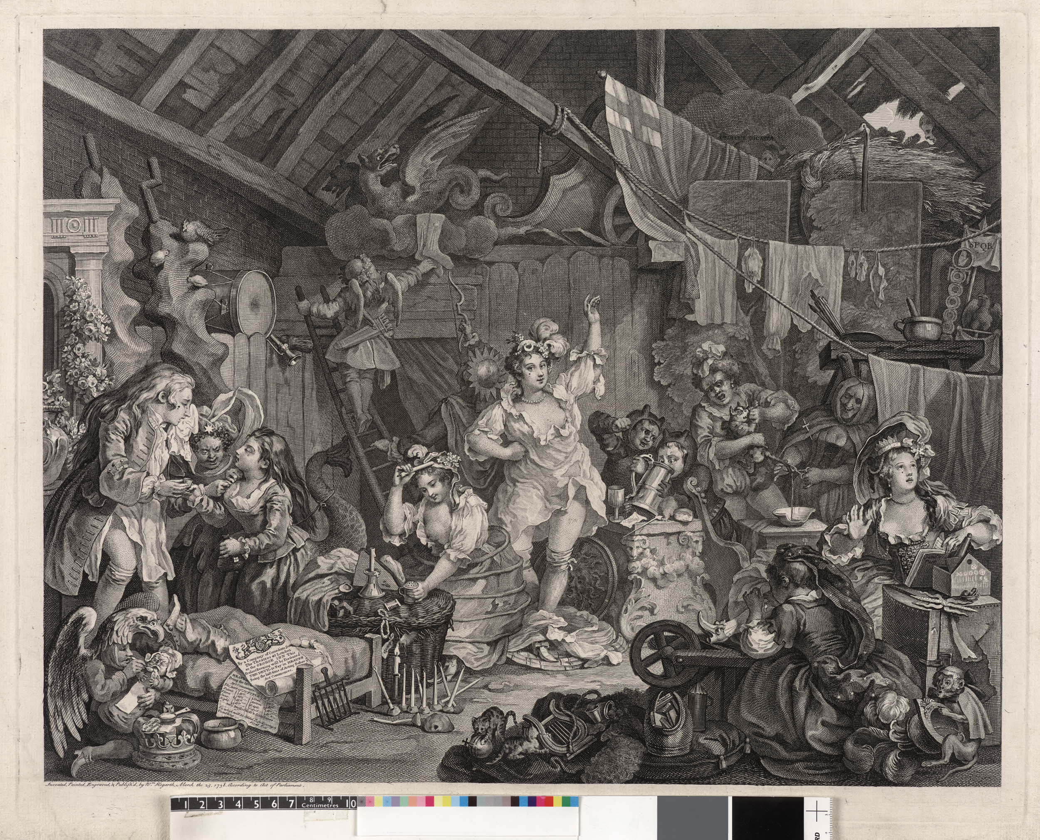
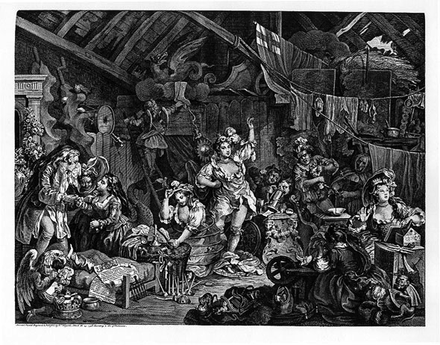
Hogarth, Strolling Actresses Dressing in a Barn, 1738 (Collection of the British Museum)
Notes:
Hogarth, Strolling Actresses Dressing in a Barn (1738)

